Slide 1




ANGULAR Data binding

Slide 2
Data Binding Classification
Two Way Binding
One Way Binding
Interpolation
Property Binding
Event Binding
The data binding keeps both component & view in sync with each other.
Notes:
From NodeJS we use few utilities like npm just to manage our project dependencies, we no need to learn node just install and use it.
Angular uses TS from MS and VS Code also from MS so it includes cool features to deal with TS like debugging etc

Slide 3
One Way Binding
In one-way binding data flows in one direction. Either from view to component or from component to view.
Binding Data From Component to View
Interpolation
Property Binding
Interpolation: allows us to include expressions as part of any string literal, which we use in our HTML. The angular evaluates the expressions into a string and replaces it in the original string and updates the view.
The syntax is as shown below
{{ templateExpression }} //expression enclosed in double curly braces
Eg:
<div>Welcome, {{firstName}} {{lastName}}</div>
Bind to an element property
<a href="/product/{{productID}}">{{productName}}</a>
The safe navigation operator ( ? )
You can make use of a safe navigation operator ( ? ) to guards against null and undefined values.
<p>The item name is: {{nullItem?.Name}}</p>

Slide 4
Property binding: allows us to bind HTML element property to a property in the component. Whenever the value of the component changes, Angular updates the element property in the View. You can set the properties such as class, href, src, etc
The Property Binding uses the following Syntax
[binding-target]=”binding-source” //(target property is enclosed in a square bracket []
Eg:
<h1 [innerText]="title"></h1>
The Binding source must be a template expression. It can be property in the component, method in component, a template reference variable or an expression containing all of them.
We can use this binding type for Class Binding, Style Binding, Attribute binding
Property Binding Vs Interpolation
Everything that can be done from interpolation can also be done using the Property binding. Interpolation is actually a shorthand for binding to the textContent property of an element.
<h1> {{ title }} </h1> same as <h1 [innerText]="title"></h1>
In fact, Angular automatically translates interpolations into the corresponding property bindings before rendering the view.
Interpolation requires the expression to return a string. If you want to set an element property to a non-string data value, you must use property binding.

Slide 5
Binding Data From View to Component
Event Binding: allows us to bind events such as keystroke, clicks, hover, touch, etc to a method in component. It is one way from view to component. By tracking the user events in the view and responding to it, we can keep our component in sync with the view.
Angular uses the following syntax for event binding
(target-event)="TemplateStatement”
Eg:
<button (click)="onSave()">Save</button>
on-
Instead of parentheses, you can also use the on- syntax as shown below.
<button on-click="clickMe()">Click Me</button>
Multiple event handlers
<button (click)="clickMe(); clickCount1=clickCount">Click Me</button>
$event Payload
<input (input)="handleInput($event)">
Template reference variable #name
<input #el (input)="handleInput1(el)">

Slide 6
Two Way binding
Two-way binding means that changes made to our model in the component are propagated to the view and that any changes made in the view are immediately updated in the underlying component
The two-way binding uses the special syntax [()],
it means both property binding and event binding
<someElement [(someProperty)]="value"></someElement>.
angular has a special directive ngModel, which sets up the two-way binding
The ngModel directive is not part of the Angular Core library. It is part of the @angular/forms. You need to import the FormsModule
Eg:
<input type="text" name="value" [(ngModel)]="value">
When you bind to a ngModel directive, behind the scene it sets up property binding & event binding. It binds to the value property of the element using property binding. It then uses the ngModelChange event to sets up the event binding to listen to the changes to the value.

Slide 7
Directives
The directive helps us to manipulate the DOM. You can change the appearance, behaviour, or layout of a DOM element using the directives. They help you to extend HTML.
The Angular directives are classified into three categories based on how they behave.
Component
Structural
Attribute Directives
The ngFor is an Angular structural directive, which repeats a portion of the HTML template once per each item from an iterable list (Collection). Note: structural directives start with *
The ngIf allows us to Add/Remove DOM Element.
Eg:
<li *ngFor="let movie of movies">
{{ movie.title }} - {{movie.director}}
</li>
The ngClass Directive is an Angular Attribute Directive, which allows us to add or remove CSS classes to an HTML element.
The ngStyle Directive is an Angular Attribute Directive, which allows us to updates the styles HTML element.
Eg: Note: Attribute directives use attribute binding
<input [(ngModel)]="color" />
<div [ngStyle]="{'color': color}">Change my color</div>
//declare color field in component class

Slide 8
Custom Directive
Genearate using cli
ng g directive changeText
Update the class as below
export class ChangeTextDirective {
constructor(Element: ElementRef) {
console.log(Element);
Element.nativeElement.innerText = "Text from Directive.";
}
}
Use in tamplate:
<span changeText >Welcome to {{title}}.</span>

Slide 9
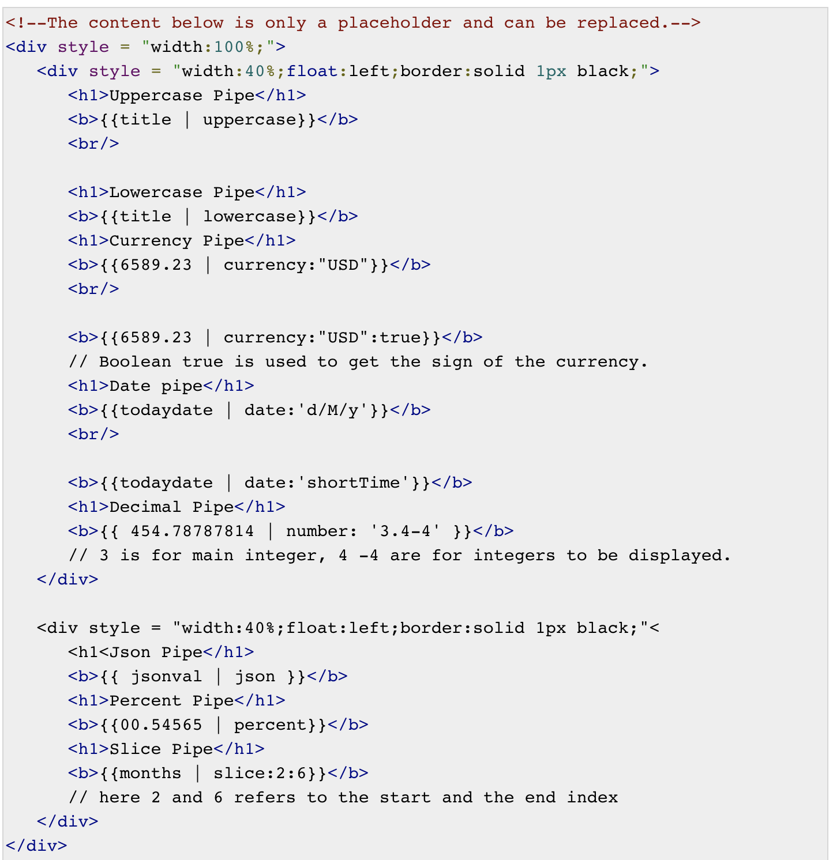
Pipes
export class AppComponent {
title = 'Angular Project!’;
todaydate = new Date();
jsonval = {name:’Dan', age:'25', address:{a1:'Mumbai', a2:'Karnataka'}};
months = ["Aug", "Sept", "Oct", "Nov", "Dec"];
}
The | character is used to transform data. Following is the syntax for the same −
{{ Angular | lowercase}}
It takes integers, strings, arrays, and date as input separated with | to be
converted in the format as required and display the same in the browser.
Built in pipes:
Lowercasepipe
Uppercasepipe
Datepipe
Currencypipe
Jsonpipe
Percentpipe
Decimalpipe
Slicepipe

Slide 10
Custom Pipe
Genearate using cli
ng g pipe sqrt
Update the class as below
import {Pipe, PipeTransform} from '@angular/core';
@Pipe ({
name : 'sqrt'
})
export class SqrtPipe implements PipeTransform {
transform(val : number) : number {
return Math.sqrt(val);
}
}
Use in tamplate:
<span>Square root of 25 is: {{25 | sqrt}}</span>

Slide 11
Services
We might come across a situation where we need some code to be used everywhere on the page.
For example, it can be for data connection that needs to be shared across components. This is achieved with the help of Services. With services, we can access methods and properties across other components in the entire project.
To create a service, we need to make use of the command line as given below
ng g service myservice
Services now will be decorated with @Injectable decorator
So that they can injected in the components directly without declaring in the providers section of module.
The Old Way of doing DI in Angular — providers: []
The New Way of doing DI in Angular — providedIn: 'root' | SomeModule
import { Injectable } from '@angular/core’;
@Injectable({ providedIn: 'root' })
export class MyserviceService {
constructor() { }
}

Slide 12
Http Client
HttpClient will help us fetch external data, post to it, etc. We need to import the http module to make use of the http service.
To use http client we need to first add HttpClientModule into imports section of our root module
import { HttpClientModule } from '@angular/common/http'
@NgModule({
imports: [ BrowserModule, AppRoutingModule, HttpClientModule ]
})
export class AppModule { }
//We will fetch the data from the server using httpclient module declared above. We will do that inside a service
import { Injectable } from '@angular/core’;
import { HttpClient } from '@angular/common/http’;
@Injectable({ providedIn: 'root' })
export class UsersService {
private apiurl = "http://jsonplaceholder.typicode.com/users/";
constructor(private http: HttpClient) { }
getData() {
return this.http.get(this.apiurl);
}
}
//Using the response in Component with subscribe (like a promise)
export class AppComponent {
public userData;
constructor(private userService: UsersService) {
ngOnInit(): void {
this.userService.getData().subscribe((data) => {
this.userData = Array.from(Object.keys(data), k=>data[k])
});
}}

Slide 13
Http Client Params
//Get with headers and error handling
const headers = { 'Authorization': 'Bearer my-token', 'My-Custom-Header': 'foobar' }
this.http.get<any>('https://api.npms.io/v2/search?q=scope:angular', { headers }).subscribe(
data => this.totalAngularPackages = data.total,
error => console.error('There was an error!', error)
})
//Post with headers
const headers = { 'Authorization': 'Bearer my-token', 'My-Custom-Header': 'foobar' }
const body = { title: 'Angular POST Request Example' }
this.http.post<any>('https://jsonplaceholder.typicode.com/posts', body, { headers }).subscribe(data => {
this.postId = data.id;
})

Slide 14
Ng-Templates
For the Span tag, we have added the if statement with the else condition and will call template condition1, else condition2.
The templates are to be called as follows −
<ng-template #condition1>Condition is valid from template</ng-template>
<ng-template #condition2>Condition is invalid from template</ng-template>
If the condition is true, then the condition1 template is called, otherwise condition2.
<div>
<span *ngIf = "isavailable;then condition1 else condition2">
Condition is valid.
</span>
<ng-template #condition1>Condition is valid from template</ng-template>
<ng-template #condition2>Condition is invalid from template</ng-template>
</div>
Notes:
In header page we have this ng-template when user logout login link will appear else username will appear

Slide 15
Forms
The data entry forms can be very simple to very complex. The Forms contain large no of input fields, a variety of fields like Text boxes, Dates, Numbers, Emails, Password, Check Boxes, Option boxes, etc. These fields can Span multiple tabs or multiple pages. Angular supports the Complexity
There are 2 ways of working with forms:
Template driven form
Model driven form (Reactive forms)
Template Driven Form
With a template driven form, most of the work is done in the template
In template driven forms, we need to create the model form controls
by adding the ngModel directive and the name attribute.
Eg:
//Component code very minimal in template driven forms
export class AppComponent {
onSubmit(data) { alert("Entered Email id : " + data.emailid); }
}
<form #userlogin = "ngForm" (ngSubmit) = "onSubmit(userlogin.value)">
<input type = "text" name = "emailid" placeholder = "emailid" ngModel> <input type = "password" name = ”pwd" placeholder = ”pwd" ngModel> <br/>
<input type = "submit" value = "submit">
</form>
if we have to read the emailid and passwd in component, we need to add the ngModel across it.
The #name syntax is a template reference which refers to the html object

Slide 16
Model Driven Form
In the model driven form, we need to import the ReactiveFormsModule from @angular/forms and use in the imports array in root module.
In the Model driven forms the form controls (fields) are created in the Component
Eg:
//Component creates the fields
import { FormGroup, FormControl } from '@angular/forms';
export class AppComponent {
emailid; formdata;
constructor() { }
ngOnInit() {
this.formdata = new FormGroup({
emailid: new FormControl(”ng@gmail.com"),
passwd: new FormControl(”abc123")
});
}
onSubmit(data) {this.emailid = data.emailid;}
}
//Template uses the fields created in Component
<div>
<form [formGroup] = "formdata" (ngSubmit) = "onSubmit(formdata.value)" >
<input type = "text" formControlName = "emailid"> <br/>
<input type = "password" formControlName = "passwd">
<input type = "submit" class = "forsubmit" value = "Log In">
</form>
</div>
<p> Email entered is : {{emailid}} </p>

Slide 17
Direct access between directive and instance
FormControl represents a single input field in an Angular form. an object that encapsulates all this information related to the single input element. It Tracks the value and validation status of each of these control
Eg:
let firstname= new FormControl(); //Creating a FormControl
firstname.valid // details visible in template
firstname.value
You can use FormControl to set the value of the Form field, find the status of form field like (valid/invalid, pristine/dirty, touched/untouched ) etc & add validation rules to it.
import { Component } from '@angular/core';
import { FormControl } from '@angular/forms';
@Component({
selector: 'app-reactive-favorite-color',
template: `
Favorite Color: <input type="text" [formControl]="favoriteColorControl">
`
})
export class FavoriteColorComponent {
favoriteColorControl = new FormControl('');
}

Slide 18
FormGroup is a collection of FormControls . Each FormControl is a property in a FormGroup. with the control name as the key.
A FormGroup tracks the status of each child FormControl and aggregates the values into one object. with each control name as the key, this avoid lot of validation checks for each field separately.
Eg:
let address= new FormGroup({
street : new FormControl(""),
city : new FormControl(""),
pinCode : new FormControl("")
})
address.value //return json obj with all fields values
address.get("street") //gives individual field value
address.valid // true if all the child controls passed the validation
A typical Angular Form can have more than one FormGroup. A FormGroup can also contain another FormGroup.

Slide 19
FormArray is an array of form controls.
It is similar to FormGroup except for one difference. In FormGroup each FormControl is a property with the control name as the key. FormArray is an array of form controls.
Eg:
contactForm = new FormGroup( {
email: new FormControl(’’, [Validators.required, Validators.email]),
skills:new FormArray([
new FormControl(’java’)
])
});
//getting form array
getSkills() {
return this.contactForm.get(”skills") as FormArray
}
//add new control
addSkill(){
this.getSkills().push(new FormControl(‘’))
}
//remove skill
removeSkill(i){
this.getSkills().removeAt(i);
}
// true if all the child controls passed the validation
skills.valid
//template
<form [formGroup]="contactForm" (ngSubmit)="onSubmit()">
<p>
<label for="email">Email </label>
<input type="text" id="email" name="email" formControlName="email">
</p>
<div *ngIf="!email.valid && (email.dirty ||email.touched)">
<div [hidden]="!email.errors.required">
email is required
</div>
<div [hidden]="!email.errors.email">
invalid email id
</div>
</div>
<div *ngFor="let control of getSkills().controls; index as i">
<input [formControl]=”getSkills().controls[i]” placeholder=“skill” />
<button (click)="removeSkill(i)">X</button>
</div>
<div>
<button (click)=”addSkill(i)">Add Skill</button>
</div>
<p>
<button type="submit">Submit</button>
</p>
</form>

Slide 20
FormBuilder is the helper API to build forms in Angular. It provides shortcuts to create the instance of the FormControl, FormGroup or FormArray. It reduces the code required to write the complex forms.
To use form builder we need to import { FormBuilder } from '@angular/forms’
Eg:
//in the component constructor create fields
constructor(private fb: FormBuilder) {
this.contactForm = this.fb.group({
firstname: [''],
lastname: [''],
email: [''],
});
}
//in this declaration we haven’t used new FormControl() explicitly
Nested FormGroup
this.contactForm = this.formBuilder.group({
firstname: [''],
email: [''],
address: this.formBuilder.group({ //address nested
city: [''],
pincode: ['']
})
})

Slide 21
Form Validation
Let us now discuss form validation using model driven form. You can use the built-in form validation or also use the custom validation approach. We will use both the approaches in the form
Angular has built-in validators such as mandatory field, minlength, maxlength, and pattern. These are to be accessed using the Validators module.
You can just add validators or an array of validators required to tell Angular if a particular field is mandatory.
we need to import Validators from @angular/forms
Lets add required and pattern matching validation for emailed field :
//Component Changes
import { FormGroup, FormControl, Validators} from '@angular/forms';
export class AppComponent {
emailid;
formdata;
ngOnInit() {
this.formdata = new FormGroup({
emailid: new FormControl("", Validators.compose([ Validators.required, Validators.pattern("[^ @]*@[^ @]*") ])),
passwd: new FormControl("")
});
}
onSubmit(data) {this.emailid = data.emailid;}
}
//form template changes
<div>
<form [formGroup] = "formdata" (ngSubmit) = "onSubmit(formdata.value)">
<input type = "text" class = "fortextbox" name = "emailid" placeholder = "emailid" formControlName = "emailid"> <br/>
<input type = "password" class = "fortextbox" name = "passwd" placeholder = "passwd" formControlName = "passwd"> <br/>
<input type = "submit" [disabled] = "!formdata.valid" class = "forsubmit" value = "Log In"> </form>
</div>
<p> Email entered is : {{emailid}} </p>
Note: the submit button is disabled if any of the form inputs are not valid

Slide 22
Custom Validation
we can define our own custom function and add the required details in it.
Eg:
//Component creates the fields and validations
import { FormGroup, FormControl } from '@angular/forms';
export class AppComponent {
emailid; formdata;
constructor() { }
ngOnInit() {
this.formdata = new FormGroup({
emailid: new FormControl("", Validators.compose([
Validators.required,
Validators.pattern("[^ @]*@[^ @]*")
])),
passwd: new FormControl("", this.validatePassword)
});
}
validatePassword(formcontrol) {
let pwd = formcontrol.value
if (pwd.length < 5 && !/[A-Z]+/.test(pwd)) {
return {"passwd" : true};
}
}
onSubmit(data) {this.emailid = data.emailid;}
}
If the characters are more than five and contains a capital letter, then only it will consider as valid and the login will be enabled.

Slide 23
Component Communication
Angular follows a two-way data flow pattern, meaning you can send data up and down the component tree
Parent to Child Communication
Child to Parent Communication
Sibling Communication With Services
For communication use below imports:
import { Component, OnInit, Input } from '@angular/core';
Parent to Child Communication
//child component
export class HeaderComponent {
constructor() { }
@Input() headerTitle: string;
}
//child template
<div> {{ headerTitle }} </div>
//parent component
export class AppComponent { title = 'angular-communication’; }
//parent template
<div style="text-align:center">
<app-header [headerTitle]="title"></app-header>
<h1>
Welcome to App!
</h1>
</div>
<router-outlet></router-outlet>

Slide 24
Child to Parent Communication
//parent component
export class AppComponent { count;
onCount(ct) {
this.count = ct;
}
}
//parent template
<div style="text-align:center">
<app-header (ctOut)=”onCount($event)">
</app-header>
<h1>
Welcome to App!
</h1>
</div>
<div> {{ count }} </div>
<router-outlet></router-outlet>
//child component
export class HeaderComponent {
constructor() { }
@Output() ctOut = new EventEmitter();
count = 0
onClickCount() {
this.ctOut.emit(count++)
}
}
//child template
<a (click)=" onClickCount()">Counter</a>

Slide 25
Sibling communication with services
//Login Component
export class LoginComponent{
constructor(private appService: AppService) { }
login() {
this.appService.setUserLoggedIn(true);
}
logout() {
this.appService.setUserLoggedIn(false);
}
}
//service
import { Injectable } from '@angular/core';
import { Subject } from 'rxjs';
@Injectable({
providedIn: 'root'
})
export class AppService {
constructor() { }
public isUserLoggedIn = new Subject();
setUserLoggedIn(loggedIn: boolean) {
this.isUserLoggedIn.next(loggedIn);
}
}
//Footer Component
export class FooterComponent implements OnInit {
constructor(private appService: AppService) { }
isUserLoggedIn: boolean;
ngOnInit() {
this.appService.isUserLoggedIn.subscribe((userLoggedIn: boolean) => {
this.isUserLoggedIn = userLoggedIn;
});
}
}

Slide 26
Passing data with routes:

Slide 29
New Method using route/state:
Note: Need to check
//source
this.router.navigate([‘home'], { state: { title: ‘BlaBla' } });
//destination
constructor(private router: Router) { console.log(this.router.getCurrentNavigation().extras.state.title); // should log out ‘BlaBla' }

Slide 30
Rx JS
Observables provide support for passing messages between parts of your application. They are used frequently in Angular and are the recommended technique for event handling, asynchronous programming, and handling multiple values.
Observer pattern is a software design pattern in which an object, called the subject, maintains a list of its dependents, called observers, and notifies them automatically of state changes. This pattern is similar (but not identical) to the publish/subscribe design pattern.
Major Components:
Observable
An observable is a function that creates an observer and attaches it to the source where values are expected, for example, clicks, mouse events from a dom element or an Http request, etc.
Observer
It is an object with next(), error() and complete() methods, that will get called when there is interaction to the with the observable i.e. the source interacts for an example button click, Http request, etc.
Subscription
When the observable is created, to execute the observable we need to subscribe to it. It can also be used to cancel the execution.
Operators
An operator is a pure function that takes in observable as input and the output is also an observable.
Subject
A subject is an observable that can multicast i.e. talk to many observers. Consider a button with an event listener, the function attached to the event using addlistener is called every time the user clicks on the button similar functionality goes for subject too.
Schedulers
A scheduler controls the execution of when the subscription has to start and notified.

Slide 31
//More observable examples (using from, interval, fromEvent etc methods)
// Create an Observable out of a promise using from method
const data = from(fetch('/api/endpoint'));
// Subscribe to begin listening for async result
data.subscribe({
next => (response) { console.log(response); },
});
// Create an Observable that will publish a value on an interval
const secondsCounter = interval(1000);
// Subscribe to begin publishing values
secondsCounter.subscribe(n =>
console.log(`It's been ${n} seconds since subscribing!`));
//Create an observable from an event
const el = document.getElementById('my-element');
const mouseMoves = fromEvent(el, 'mousemove');
// Subscribe to start listening for mouse-move events
const subscription = mouseMoves.subscribe((evt: MouseEvent) => {
console.log(evt);
}
//creating observable
of(...items) //Returns an Observable instance that synchronously delivers the values provided as arguments.
from(iterable) //Converts its argument to an Observable instance. This method is commonly used to convert an array to an observable.
//Create simple observable that emits values using of method
const myObservable = of(1, 2, 3);
// Create observer object
const myObserver ={
next: x => console.log('Observer got a next value: ' + x),
error: err => console.error('Observer got an error: ' + err),
complete: () => console.log('Observer got complete notification')
};
// Execute with the observer object
myObservable.subscribe(myObserver);
// Logs:
// Observer got a next value: 1
// Observer got a next value: 2
// Observer got a next value: 3
// Observer got a complete notification
//Same above with simple syntax we regularly use:
myObservable.subscribe(
x => console.log('Observer got a next value: ' + x),
err => console.error('Observer got an error: ' + err),
() => console.log('Observer got a complete notification')
);

Slide 32
Operators
Operators are functions that build on the observables foundation to enable sophisticated manipulation of collections. For example, RxJS defines operators such as map(), filter(), concat(), and flatMap().
//using map operator which maps using observable stream
const nums = of(1, 2, 3);
const squareValues = map((val: number) => val * val);
const squaredNums = squareValues(nums);
squaredNums.subscribe(x => console.log(x));
// Logs
// 1, 4, 9
// Pipes let you combine multiple functions into a single function. The pipe() function takes as its arguments the functions you want to combine, and returns a new function that, when executed, runs the composed functions in sequence.
const nums = of(1, 2, 3, 4, 5);
// Create a function that accepts an Observable.
const squareOddVals = pipe(
filter((n: number) => n % 2 !== 0),
map(n => n * n)
);
// Create an Observable that will run the filter and map functions
const squareOdd = squareOddVals(nums);
// Subscribe to run the combined functions
squareOdd.subscribe(x => console.log(x));
//Samething with regular syntax
const squareOdd = of(1, 2, 3, 4, 5).pipe(
filter(n => n % 2 !== 0),
map(n => n * n)
);
squareOdd.subscribe(x => console.log(x));
Table of operators:
AREA | OPERATORS
Creation | from,fromEvent, of
Combination | combineLatest, concat, merge, startWith , withLatestFrom, zip
Filtering | debounceTime, distinctUntilChanged, filter, take, takeUntil
Transformation | bufferTime, concatMap, map, mergeMap, scan, switchMap
Utility | tap
Multicasting | share

Slide 33
Bootstrap CSS installation
npm install --save bootstrap
npm install --save jquery
After installation update root level style css file as below
@import "~bootstrap/dist/css/bootstrap.css"

